Slide 1

The Battle of the Neighborhoods, but make it Miami
IBM/Coursera Applied Data Science Capstone Project
Submitted by: Carolina Belmonte

Slide 2
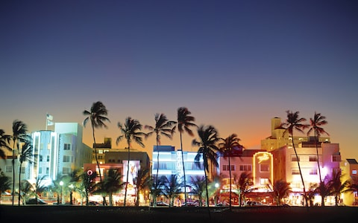
This is Miami, my hometown. It is also the subject of this exploration.
Credit: Walter Bibikow, via The Telegraph

Slide 3
Introduction
“Miami, officially the City of Miami, is the seat of Miami-Dade County, and the cultural, economic and financial center of South Florida in the United States.”
If you think I'm making up the bit above, I invite you to navigate to Google and enter "Miami, Florida" in the search bar :) As a Miami native, I've had the privilege of always being able to boast that I live where people vacation.
However, no place is perfect - Miami real estate is almost prohibitively expensive for your average citizen. This conundrum has left me wondering - for many years, in fact - how can we look for reasonably priced real estate in an area of Miami that still has a lot to offer? Thus, our target audience is middle class potential home buyers looking to maximize their ability to enjoy Miami’s venue offerings while still paying a reasonable price for a property.
Given that Miami is an ever growing metropolis that continuously attracts people, potential home buyers, investors and city planners would be interested in this data.

Slide 4

Data
Miami’s zip codes and corresponding latitude and longitude coordinates were taking from a public data set from ODS
The data set on Miami’s properties (values, location, and all other relevant features) was taken from Miami-Dade County’s open data hub.
Data on nearby venues was obtained from Foursquare’s API
Icon made by Eucalyp from Flaticon

Slide 5
Methodology
Data collection from ODS and MDC sites
Data insertion into my Jupyter notebook was done directly by making use of IBM Watson Studio’s storage
Data preprocessing done in Notebook, leveraging Numpy and Pandas
Venue data was obtained via calls to the Foursquare API
Data modelling was done through the use of the unsupervised K Means Clustering technique
Data visualization was achieved with a combination of Geopy and Folium to render maps of the clustered zip codes
Direct (manual/human) observation and analysis of the data frames of the clustered zip codes was also used to arrive at the final recommendation

Slide 6
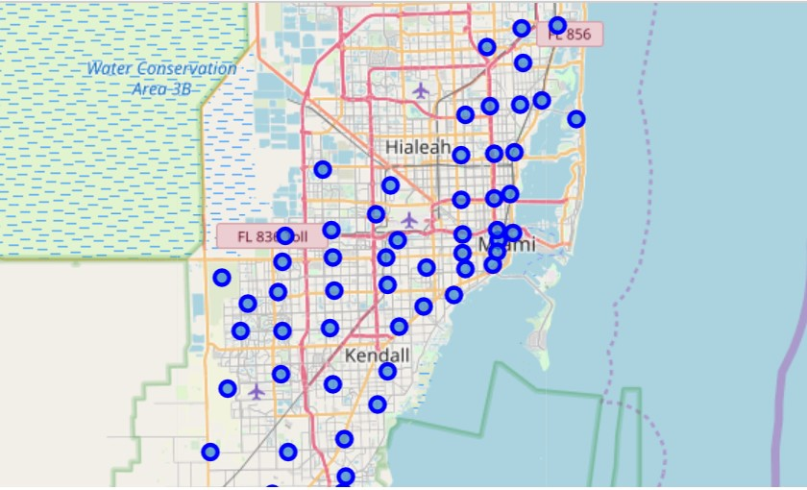
Results
Miami zip codes before clustering:

Slide 7
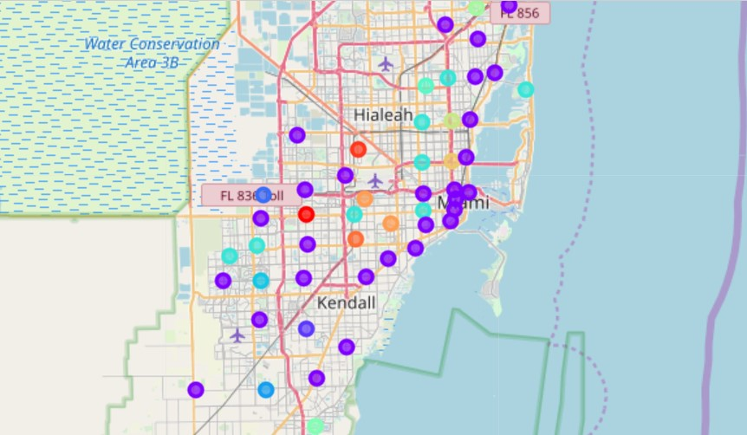
Results
Miami zip codes before after clustering:

Slide 8

Results
From looking at the clustered map, we can see that one of the clusters (purple) has an abnormal looking density and contains most of the zip codes.
As a result, I wanted to take a closer look at the data in each cluster. It seems that Cluster 1 (purple) is not very indicative, but Cluster 6 is a potential gold mine.
The rest of the clusters are far too sparse to be useful.
For an in depth look at the data associated to each cluster, please explore in more detail in my notebook.
Icon made by Phatplus from Flaticon

Slide 9
Discussion
After closely looking at each cluster, it seems there is much room for improvement. Zip codes were densely clustered between Clusters 1 and 6. Cluster 1 is all over the place and doesn't provide much insight. However, Cluster 6 is our gold mine. We can see that the zip codes in Cluster 6 boast very reasonable property prices, fair bed/bath distribution and access to a plethora of awesome nearby venues. Based on this finding, I would recommend that any average buyer looking to purchase real estate in Miami, Fl further explore the zip codes in Cluster 6.
In terms of where to steer these efforts in the future, my thoughts are as follows: Given the complexity of a city like Miami, very different approaches can be tried in clustering and classification studies. However, not every method can yield the same high quality results for this metropolis. I used the KMeans Clustering because of its speed and efficacy. However, given the results it is clear that for more in-depth guidance, the data set should be expanded and the details of the neighborhood and/or street should be further looked into. I hope that as this information is refined, it would be subsequently turned into an easy to access web app that can be accessed via mobile or even a chat-based interface!

Slide 10
Conclusion
We set out to recommend Miami viable zip codes for average home buyers who want to pay reasonable prices but still have access to a good variety of Miami's venues. We did so by gathering zip code data, property data and Foursquare location data on the city of Miami. We used this information to cluster Miami zip codes and then further explore those clusters. As time goes on, I hope to refine this project so that I may share it with my friends and network of real estate agents in Miami - we have all been curious about this for as long as I can remember and currently only have anecdotal data to serve us.

